Slide 1
Integrated Crop Protection Management
PIP2001 Capstone Project
Final Review
Batch Number: CSE-113
Roll Number
Student Name
20211CSE0757 | B.ARAVIND TEJA
20211CSE0756 | A.MANIDEEP
20211CSE0726 | K.KOUSHIK KALYAN
20211CSE0792 | S.VISHNU SAI
20211CSE0782 | CH.SATHWIK
Under the Supervision of,
Mr. K Rajesh
Asst Professor
School of Computer Science and Engineering
Presidency University
Name of the Program: CSE
Name of the HoD: Dr. Blessed Prince P/Dr. Robin Rohit / Dr. Asif Mohammed H.B
Name of the Program Project Coordinator: Mr. Amarnath J.L & Dr. Jayanthi. K.
Name of the School Project Coordinators: Dr. Sampath A K / Dr. Abdul Khadar A / Mr. Md Ziaur Rahman

Slide 2
Content
Problem Statement
Github Link
Introduction
Proposed Methodology
Timeline
References
Conclusion

Slide 3
Problem Statement Number:
Organization: Agriculture And Rural Development
Category (Hardware / Software / Both) : Software
Problem Description: A recommendation system is used to recommend the crops that can be sown depending on the climate, monsoon, soil condition, market for crops and other resources to enhance yield and profits This app assists farmers in making informed decisions about cultivation and is farmer-friendly. AgroDoc -the one-stop app for farmers brings Artificial Intelligence facilities at fingertips.
Difficulty Level: Simple

Slide 4
GitHub Link
The GitHub link provided should have public access permission.
GitHub Link:- https://github.com/AravindTeja75

Slide 5
Introduction
India is an ever-developing country, and today we have stepped in the era of digitalization, whose torch is being carried on the frontlines by our Prime Minister Mr. Narendra Modi. India has large population and majority of total population dependent on the agriculture sector.
By the idea of digitalization, now we want to transform traditional agriculture into modern agriculture with the help of internet of things and artificial intelligence.
Integrated Crop Protection (ICP) is a holistic approach that combines various agricultural practices to manage pests, diseases, and weeds while minimizing the environmental impact. ICP emphasizes the use of multiple strategies, including biological, cultural, mechanical, and chemical methods, to maintain crop health and maximize yield sustainably.
The escalating use of pesticides in agriculture has raised concerns regarding environmental health, human safety, and the development of pest resistance. Given these challenges, the need for Integrated Crop Protection has become critical. This project focuses on evaluating existing ICP methods and identifying gaps which can lead to more effective and sustainable practices.
This project suggests a system which can provide more accurate results related to the identification and classification of disease. It tries to replace the need of the experts to certain extent. Here, the captured image is first preprocessed to resize it .In the last step, these features are given to the classifier to classify the disease occurred on the leaf.

Slide 6
Proposed Method
Educating Farmers
Develop training programs for farmers on Integrated Crop Protection principles. This includes the importance of biodiversity, ecosystem services, and the use of alternative pest control measures.
Cultural Practices Improvement
Integrate cultural practices such as timely planting, proper irrigation, and nutrient management to enhance plant vigor, making them less susceptible to pests.
Pest Monitoring and Thresholds
Establish monitoring protocols to determine pest populations as well as economic thresholds. This ensures that interventions are only implemented when necessary, reducing unnecessary pesticide use.
Selective Use of Pesticides
When chemical interventions are necessary, adopt a selective and minimalistic approach, prioritizing eco-friendly and less harmful pesticides. This should be guided by the results from regular monitoring.
Feedback and Adaptive Management
Develop a feedback loop where farmers can report outcomes and refine strategies over time. Regular evaluations of the implemented practices can help adapt the methods based on their effectiveness.
Community Involvement
Foster collaboration among farmers, agricultural extension workers, and researchers to exchange knowledge and improve Integrated Crop Protection strategies continuously.

Slide 7
Methodology
Site Selection: Identify agricultural fields to conduct the experiments.
Baseline Survey: Collect data on pest populations and crop health prior to implementing management interventions.
Implement Integrated Methods: Apply selected ICP techniques (e.g., cultural, biological, and mechanical controls).
Monitoring and Data Collection: Use drones and sensors to monitor pest levels and crop health.
Analysis: Compare the effectiveness of different strategies in controlling pests and promoting crop health.

Slide 8
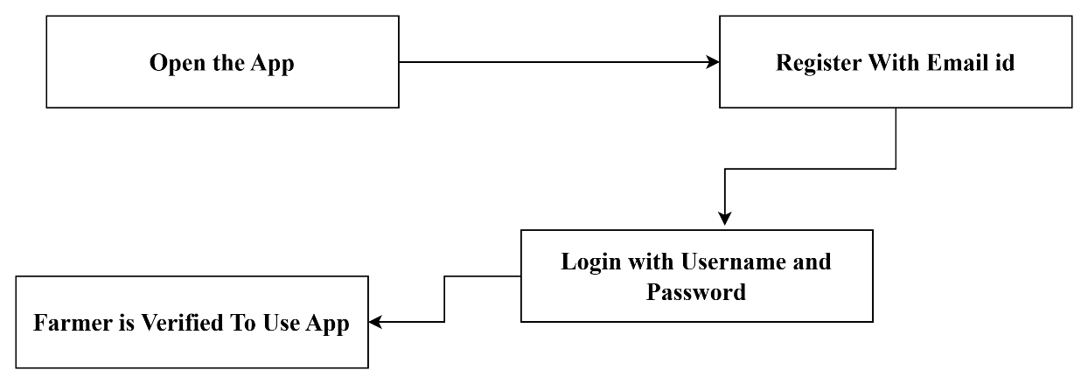
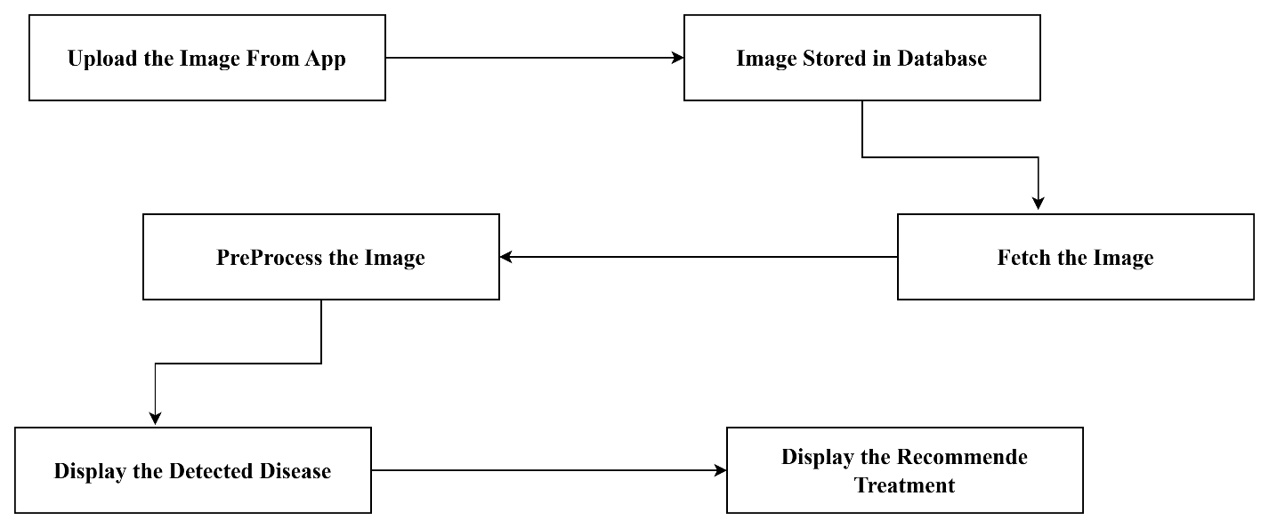
Architecture
HOW FARMERS REGISTRATION WORKS?
HOW FARMERS DISEASE IDENTIFICATION WORKS?

Slide 9
Timeline of Project
Project Duration : 4 months
Review 0
Literature
Review 1
Review 2
Review 3
FAINAL
Survey
Identification of modules.
Implementing modules.
Collecting the data and Model Training and Testing the developed model.
Final Preparation and publishing of papers and maintenance.
Testing of modules.

Slide 10

Output Screenshots
Outputs:

Slide 11

Conclusion
Outputs:

Slide 12
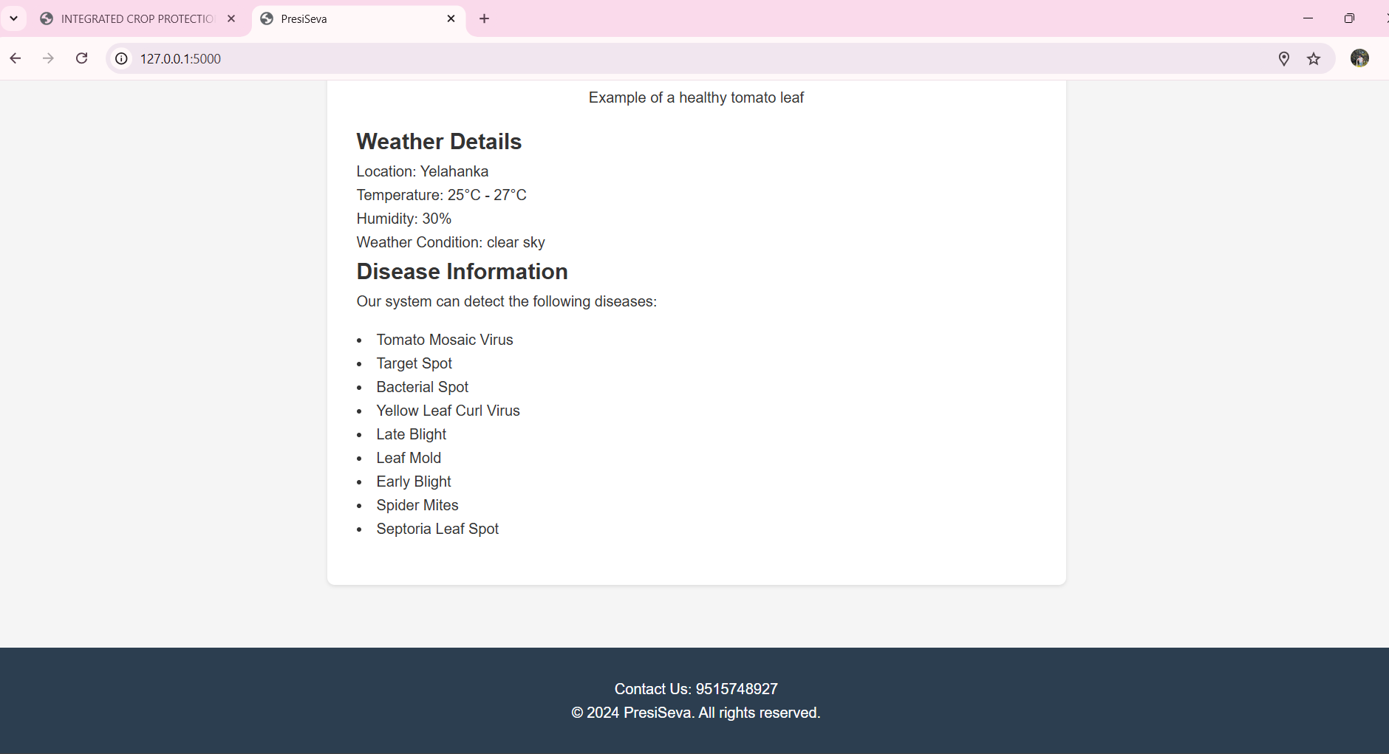
Conclusion
Outputs:

Slide 13
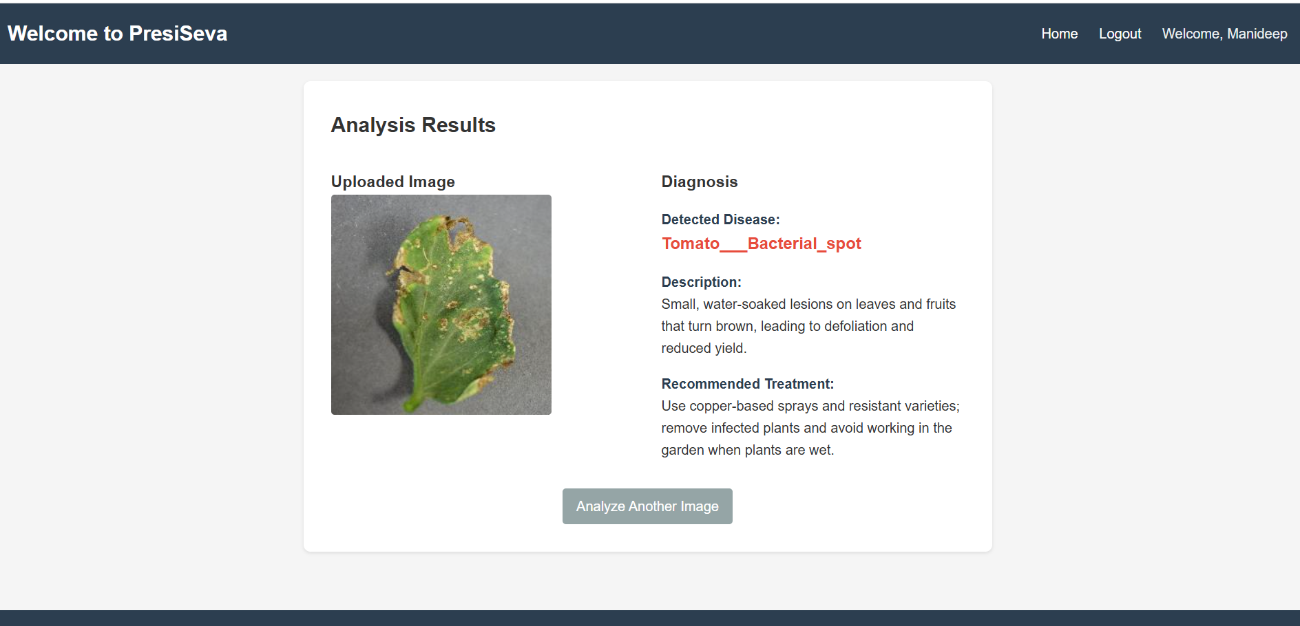
Conclusion
Outputs:

Slide 14
Conclusion
Integrated Crop Protection and Management represents a holistic, science-driven approach to modern agricultural challenges. By seamlessly integrating traditional practices with cutting-edge technologies, ICPM ensures sustainable productivity and environmental preservation. This approach provides a robust framework for enhancing food security, mitigating ecological damage, and fostering resilient farming systems.
The journey towards widespread adoption of ICPM requires overcoming significant barriers, including financial constraints, knowledge gaps, and policy limitations. Governments and stakeholders must collaborate to create an enabling environment for farmers. Investments in education, infrastructure, and research will be instrumental in mainstreaming ICPM practices. With concerted efforts, ICPM can redefine the future of agriculture, balancing productivity with sustainability to meet global food demands sustainably.

Slide 15
References (IEEE Paper format)
T. Bak et al. Agricultural robotic platform with four-wheel steering for weed detection Biosystem. Eng. (2004)
R. Cullen et al. Economics and adoption of conservation biological control Biol. Control (2008)
G.J.K. Griffiths et al. Efficacy and economics of shelter habitats for conservation biological control Biol. Control (2008)
V. Le Féon et al. Intensification of agriculture, landscape composition and wild bee communities: a target-oriented study in four European countries Agric. Ecosystem. Environ. (2010)
M. Loghavi et al. Development of a target-oriented weed control system Comput. Electron. Agric. (2008)
A. Maiorano et al. A dynamic risk assessment model (FUMAgrain) of fumonisin synthesis by Fusarium verticillioides in maize grain in Italy Crop Prot. (2009)

Slide 16

Thank You

